Slide 1

Neural Networks
Multi-label classification

Slide 2
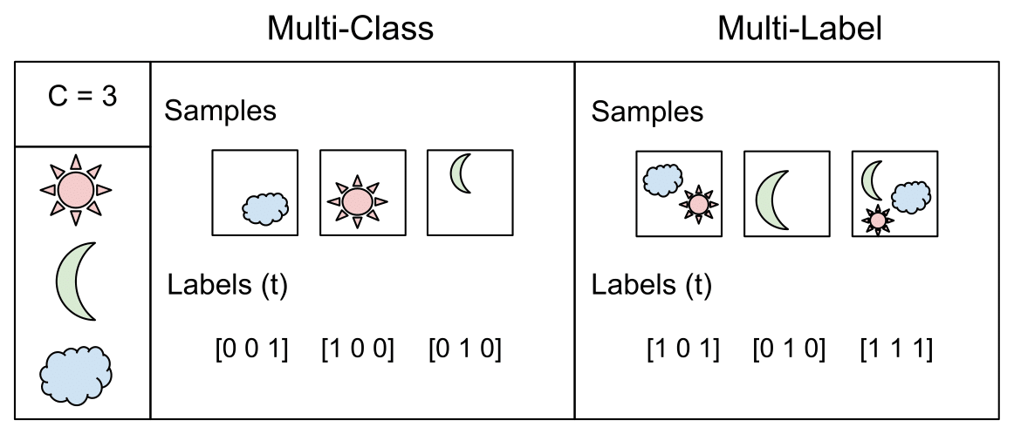
Multi-Class verses Multi-Label

Slide 3
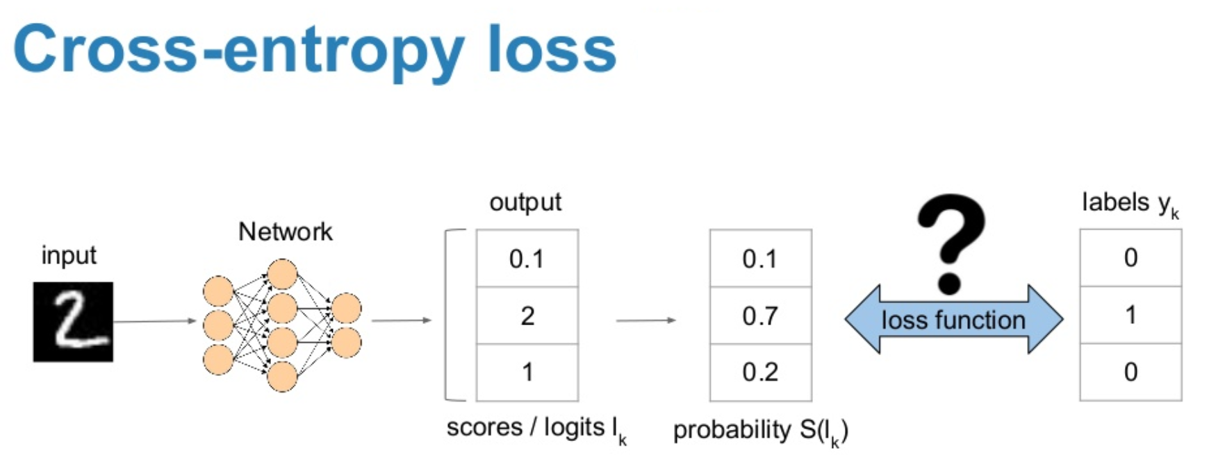
Notes:
(FYI – best wel pittig om te begrijpen, buiten de scope van dit vak: https://www.youtube.com/watch?v=ErfnhcEV1O8 : wat entropy en cross entropy juist betekent, zelfs in de context van Shannon theory). Niet kennen voor het examen.

Slide 4
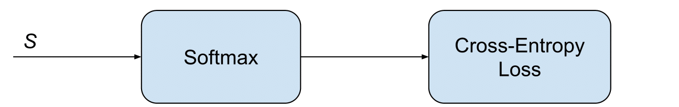
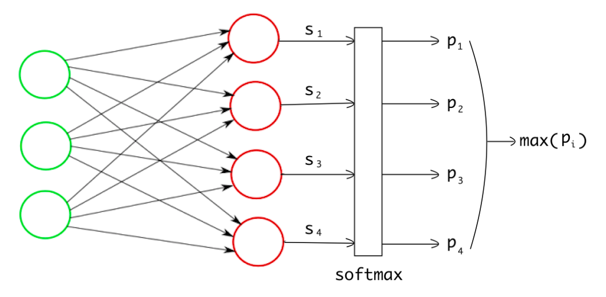
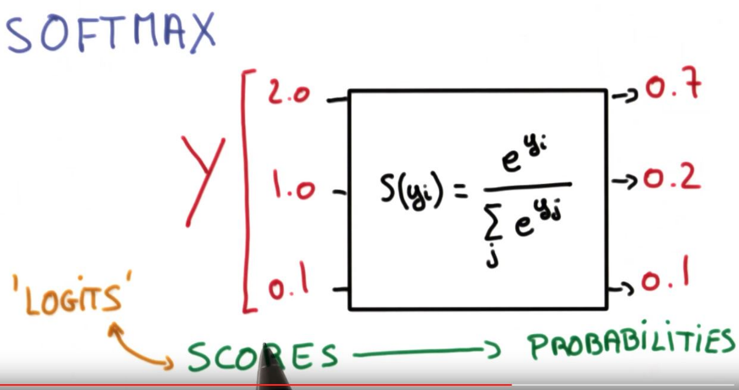
Multi-Class Classification
Activiation function: Softmax
Loss Function: Categorical Crossentropy
Notes:
https://towardsdatascience.com/multi-label-image-classification-with-neural-network-keras-ddc1ab1afede
https://gombru.github.io/2018/05/23/cross_entropy_loss/
Categorical crossentropy = softmax activation function + cross entropy loss
De logits = uitkomst van de affine functions (aW+b), dat daarna door een non-linear part wordt gedaan, de softmax (squashing naar probabilities tussen verschillende categorieën).

Slide 5
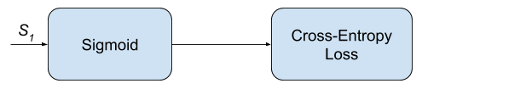
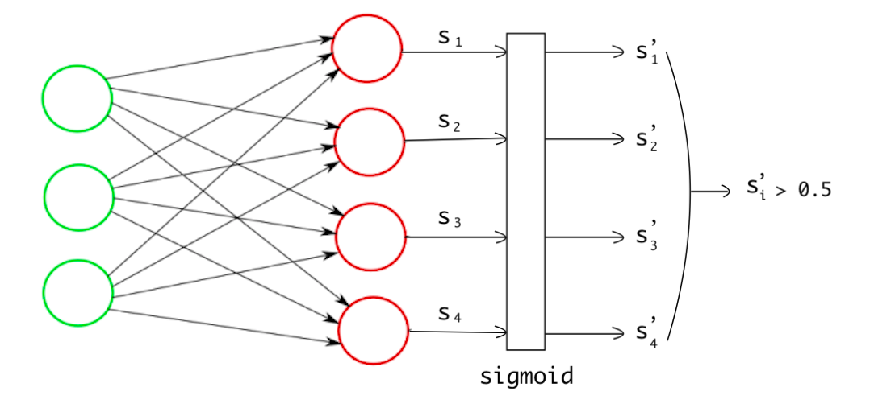
Multi-Label Classification
Activiation function: Sigmoid
Loss Function: Binary Crossentropy
Notes:
Binary crossentropy = sigmoid activation + cross entropy loss
Let wel op: voor multi-label classification: regelmatig een probleem met unbalanced datasets…hoe moet je daar nu mee om gaan. Want gewone up/downsampling werkt nu niet echt meer. Ook augmentation technieken niet echt… → omdat je nu immers data kan krijgen met verschillende combo’s van labels. En als je sampling technieken zou gebruiken, dan creëer je bias in je data door bepaalde combo’s te veel/weinig voor te stellen, of altijd in een bepaalde ‘verhouding’ tov elkaar.
= active research field…

Slide 6
Neural Networks
Segmentation

Slide 7
Segmentation

Slide 8
Computer Vision Evolution
Image Classification
Understand what is in the picture
Object Recognition and Detection: Classificiation + Localisation
Understand what, and where via Bounding Boxes
Semantic Segmentation
Understand what, and where by classifying each pixel to the what
Instance-aware Semantic Segmentation
Subclass of semantic segmentation (what+where by pixelwise classification of objects), and adding an ID to each object

Slide 9
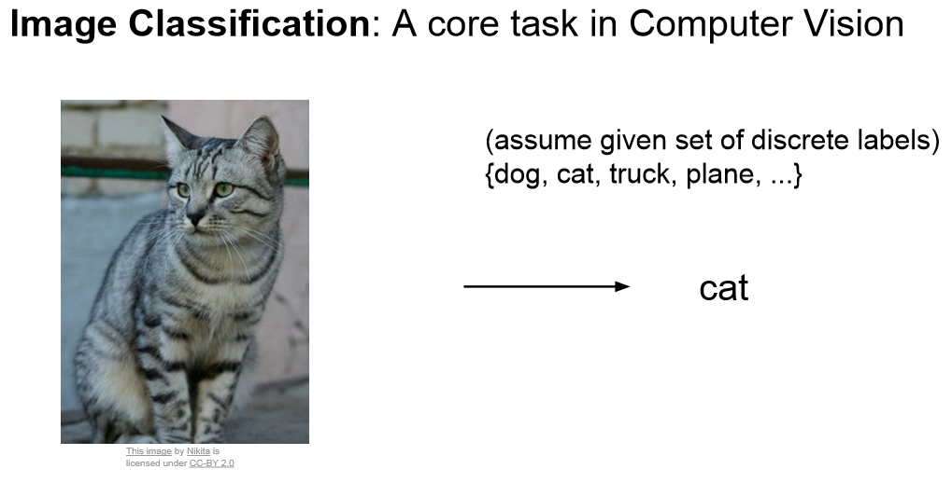
Notes:
https://towardsdatascience.com/understanding-semantic-segmentation-with-unet-6be4f42d4b47

Slide 10
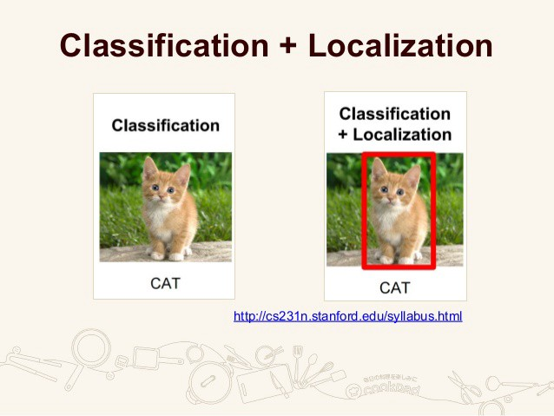
Notes:
In localization along with the discrete label, we also expect the compute to localize where exactly the object is present in the image. This localization is typically implemented using a bounding box which can be identified by some numerical parameters with respect to the image boundary. Even in this case, the assumption is to have only one object per image.

Slide 11
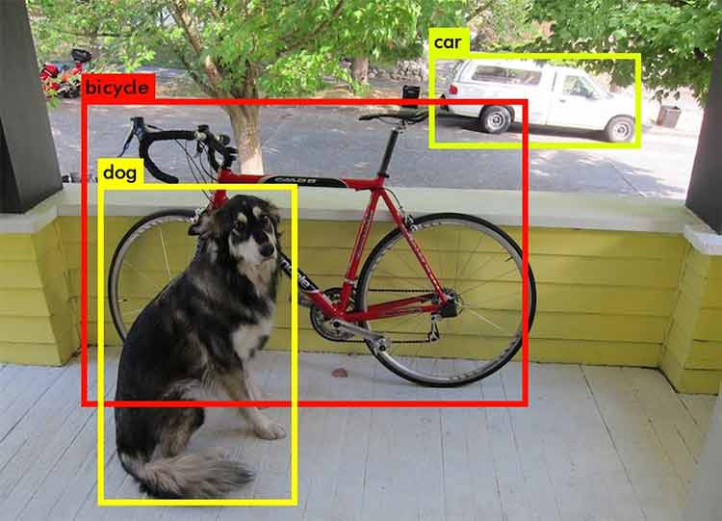
Object Detection (bounding boxes)
Notes:
Object Detection extends localization to the next level where now the image is not constrained to have only one object, but can contain multiple objects. The task is to classify and localize all the objects in the image. Here again the localization is done using the concept of bounding box.

Slide 12
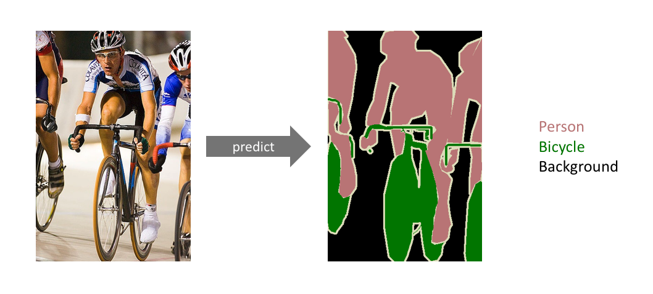
Semantic Segmentation
Notes:
The goal of semantic image segmentation is to label each pixel of an image with a corresponding class of what is being represented. Because we’re predicting for every pixel in the image, this task is commonly referred to as dense prediction.
Note that unlike the previous tasks, the expected output in semantic segmentation are not just labels and bounding box parameters. The output itself is a high resolution image (typically of the same size as input image) in which each pixel is classified to a particular class. Thus it is a pixel level image classification.

Slide 13
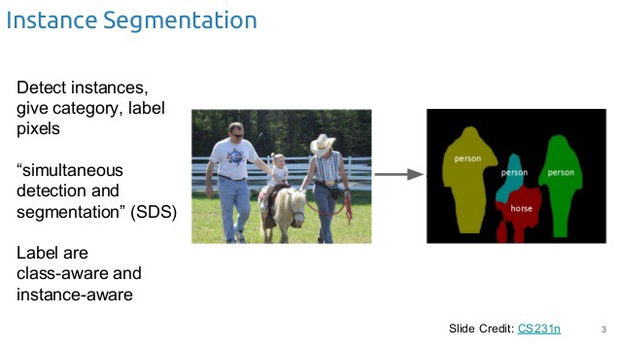
Notes:
Instance segmentation is one step ahead of semantic segmentation wherein along with pixel level classification, we expect the computer to classify each instance of a class separately. For example in the image above there are 3 people, technically 3 instances of the class “Person”. All the 3 are classified separately (in a different color). But semantic segmentation does not differentiate between the instances of a particular class.

Slide 14
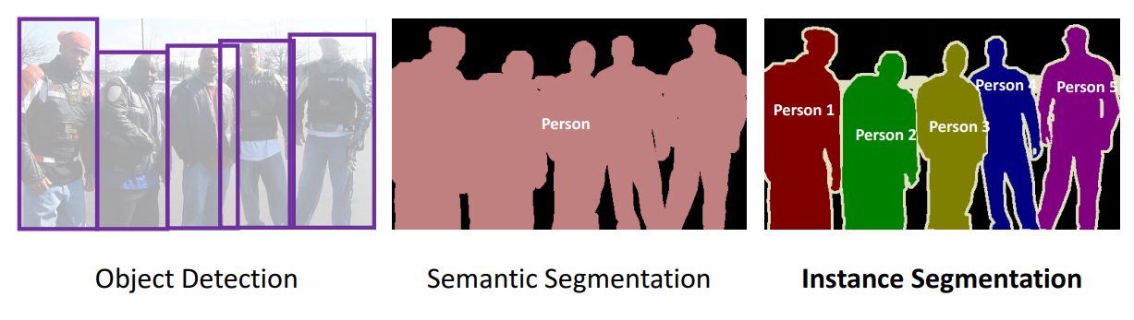

Slide 15
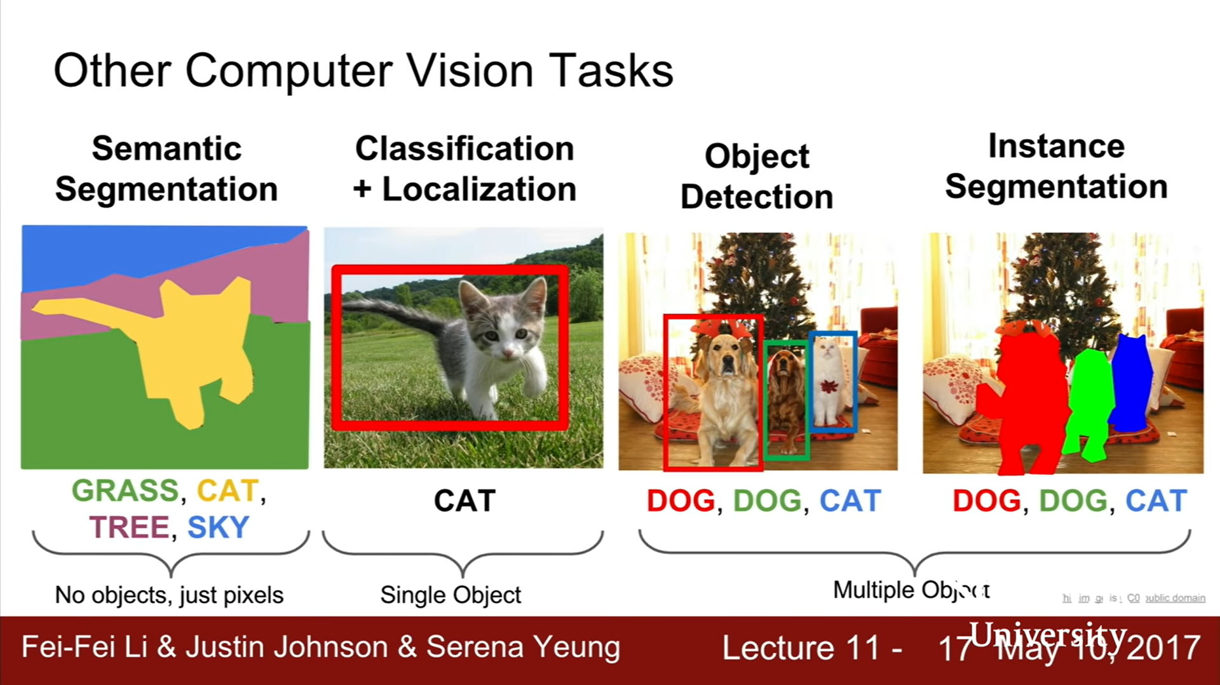
Notes:
https://www.youtube.com/watch?v=nDPWywWRIRo&t=425s

Slide 16
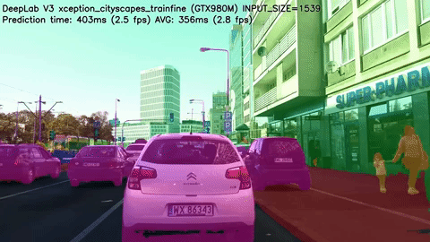
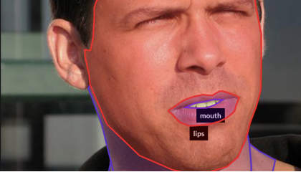
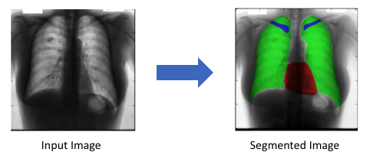
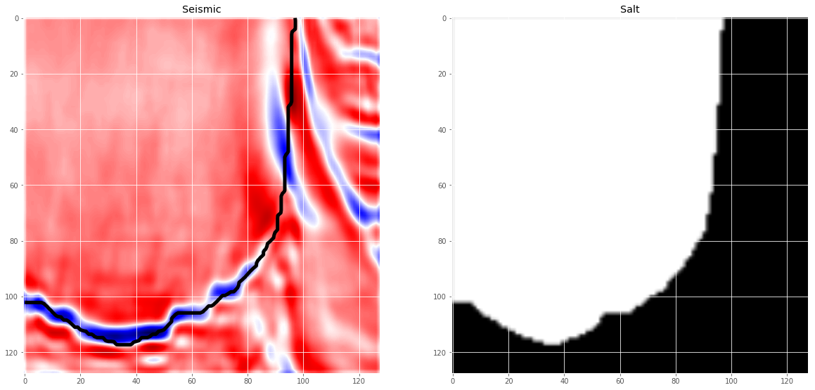
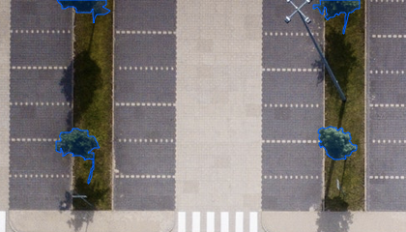
Use cases: Segmentation
Notes:
https://blog.playment.io/semantic-segmentation/

Slide 17
Classification + Localization

Slide 18
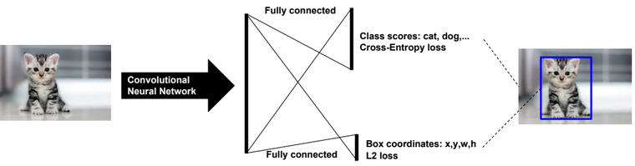
Classification & Localization
Notes:
http://sqlml.azurewebsites.net/2017/09/12/convolutional-neural-network/

Slide 19
Object Detection

Slide 20

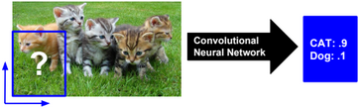
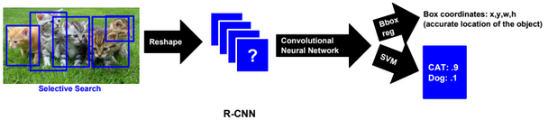
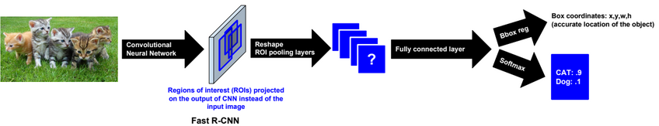
Object Detection
Sliding Window (very slow)
Selective Search / Region Based R-CNN (slow)
Fast R-CNN
Notes:
https://cv-tricks.com/object-detection/faster-r-cnn-yolo-ssd/

Slide 21
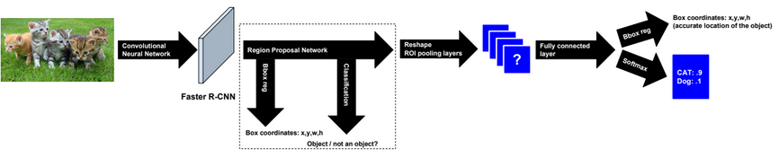
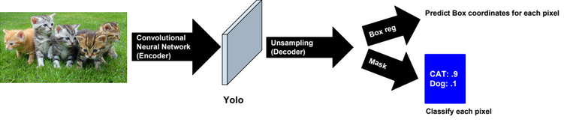
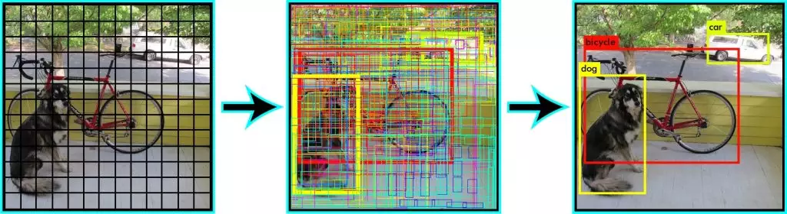
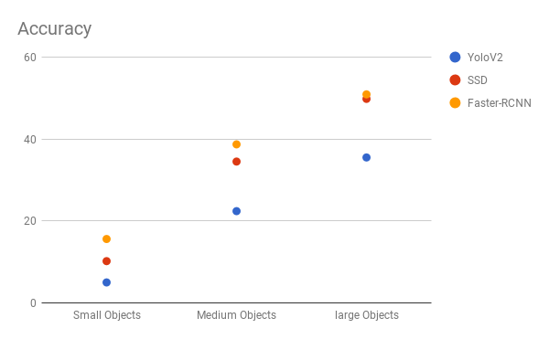
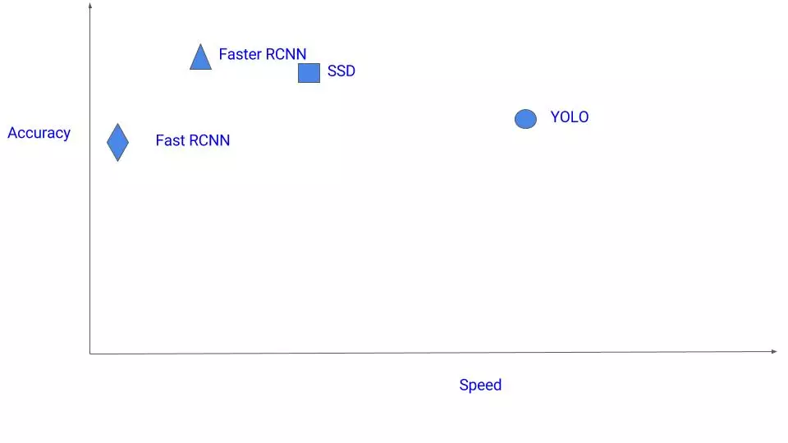
Faster R-CNN
Yolo
You only look once
SSD (Single Shot Detector)

Slide 22
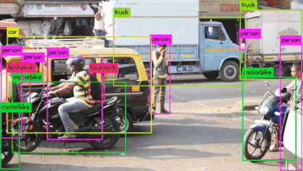
YOLOv3 for the win…

Slide 23
Semantic Segmentation

Slide 24
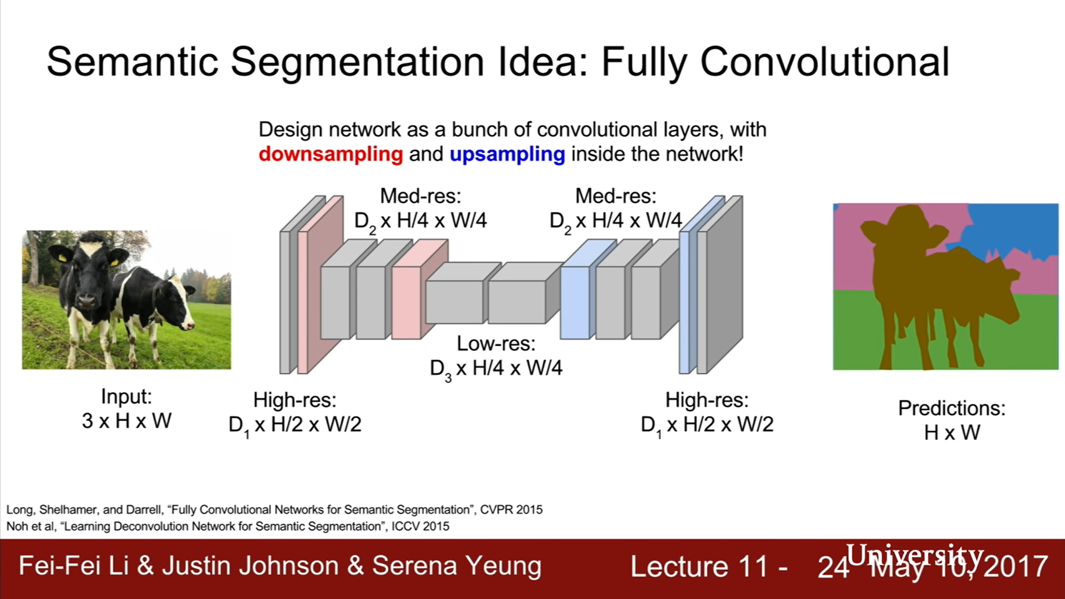
Notes:
First half is the encoder. Stripping the image down via convolutions en poolings to determine the what.
Second half of the network is de decoder. Determines the where. Uses upsampling : transpose convolutions / deconvoltions.

Slide 25



Transpose Convolutions (‘deconvolution’)
Regular convolution
Transposed convolution
Transposed convolution, strides=2, valid padding
Notes:
http://www.cvc.uab.es/people/joans/slides_tensorflow/tensorflow_html/layers.html

Slide 26
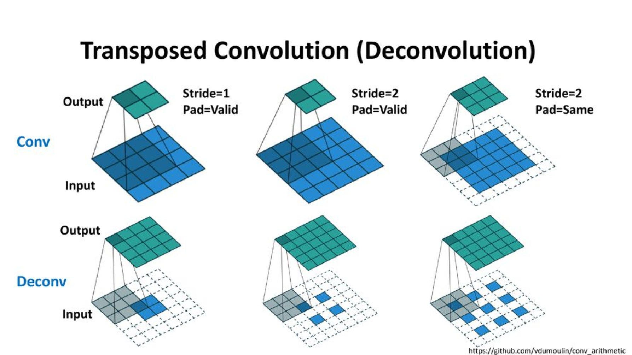

Slide 27
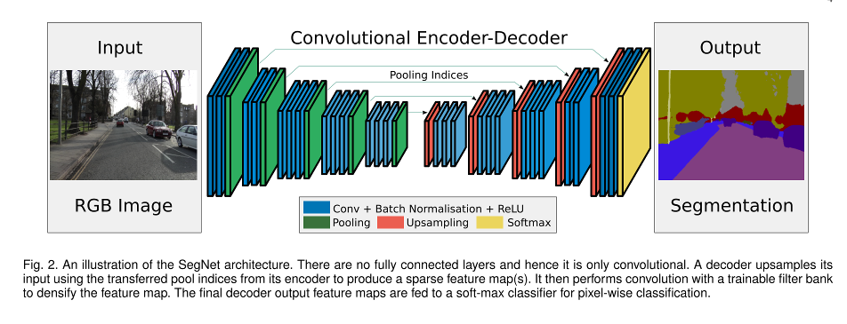
SegNet

Slide 28
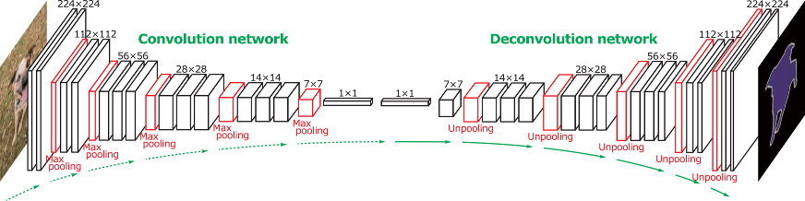
DeconvNet

Slide 29
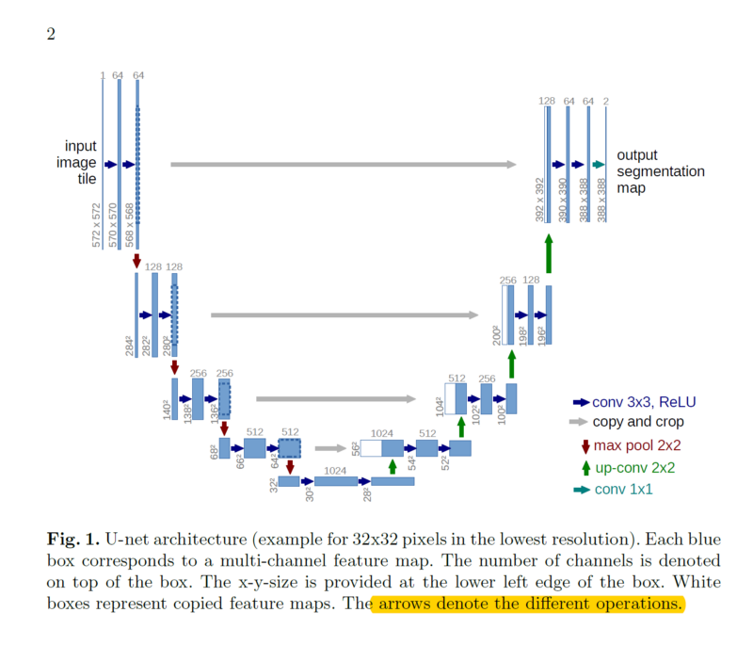
U-NET
Notes:
Unet uses the same principle of ‘skip connections’, same as ResNet/DenseNet.

Slide 30
Instance Segmentation

Slide 31
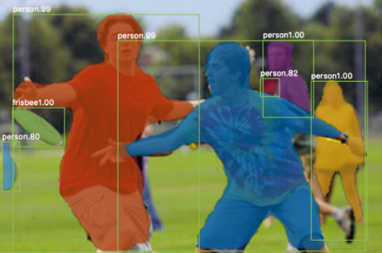
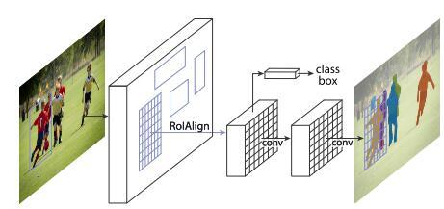
Mask R-CNN

Slide 32
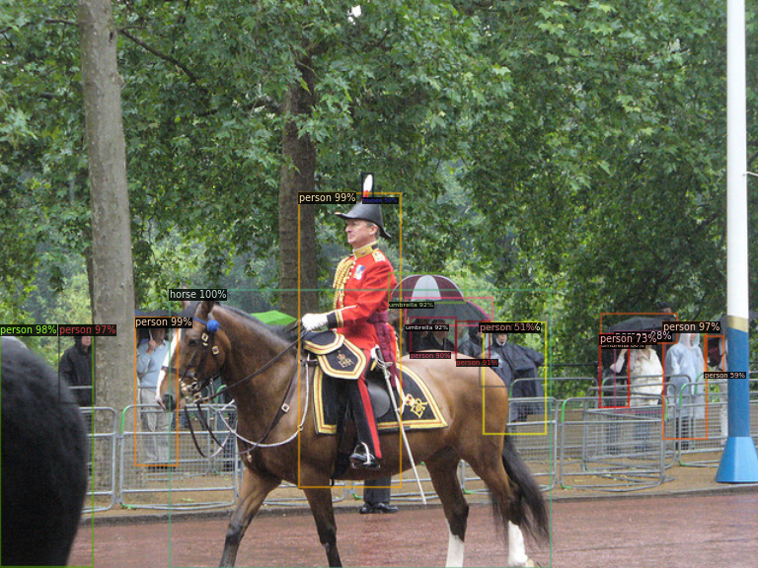
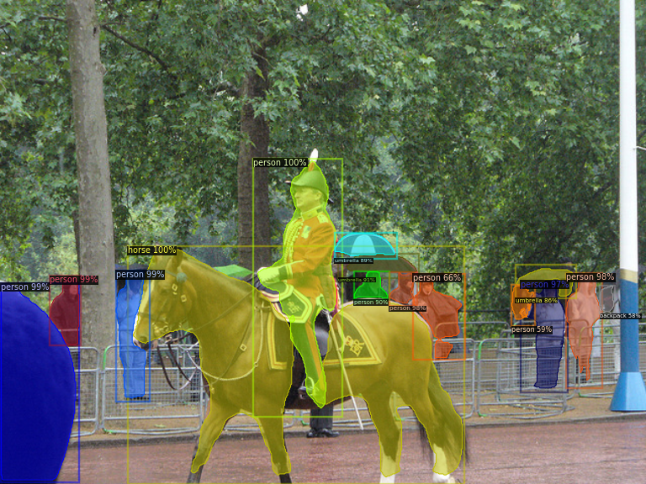
Detectron2 (PyTorch)
Notes:
https://gilberttanner.com/blog/detectron-2-object-detection-with-pytorch

Slide 33
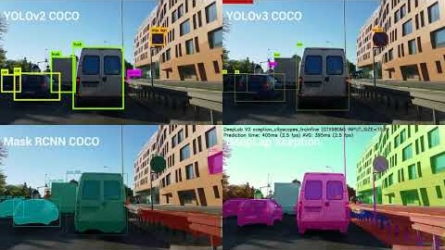

Slide 34
Segmentation Datasets

Slide 35
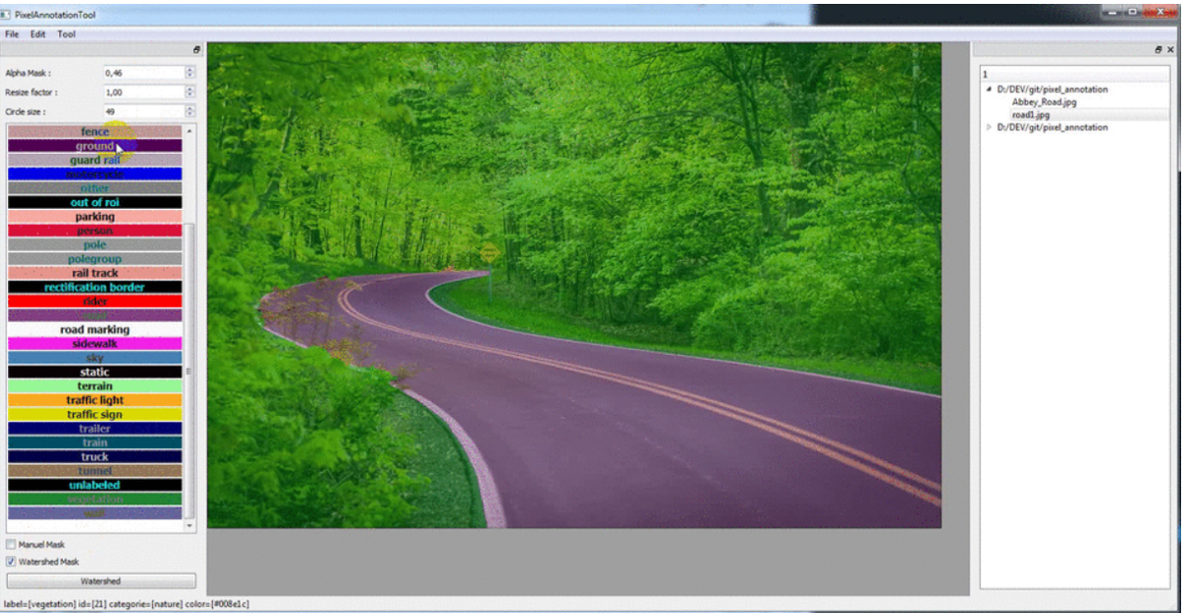
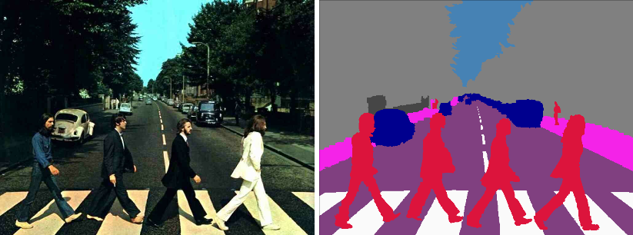
Own Segmentation Datasets
For segmentation datasets, you need to give every pixel in an image a color specific to its class for training…
Use annotation tools, like PixelAnnotationTool
Notes:
https://gilberttanner.com/blog/fastai-image-segmentation

Slide 37
Multilabel best:
https://www.cntk.ai/pythondocs/CNTK_103B_MNIST_LogisticRegression.html
https://towardsdatascience.com/multi-label-image-classification-with-neural-network-keras-ddc1ab1afede

Slide 38
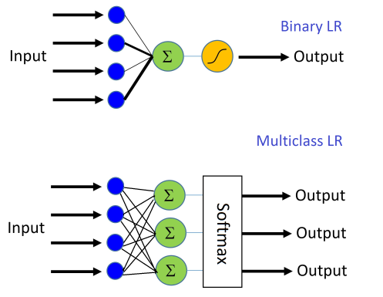

Slide 40
https://www.slideshare.net/xavigiro/loss-functions-for-deep-learning-javier-ruiz-hidalgo-upc-barcelona-2018
https://www.google.com/imgres?imgurl=https%3A%2F%2Fgombru.github.io%2Fassets%2Fcross_entropy_loss%2Fmulticlass_multilabel.png&imgrefurl=http%3A%2F%2Fgombru.github.io%2F2018%2F05%2F23%2Fcross_entropy_loss%2F&docid=aGRhgxiAq7i73M&tbnid=_7wETGWwL8awhM%3A&vet=10ahUKEwiU5aOTxfjlAhUNAxAIHaDcB5sQMwhSKAowCg..i&w=1162&h=498&bih=888&biw=1920&q=softmax%20sigmoid%20lossfunction&ved=0ahUKEwiU5aOTxfjlAhUNAxAIHaDcB5sQMwhSKAowCg&iact=mrc&uact=8

